Slide 1
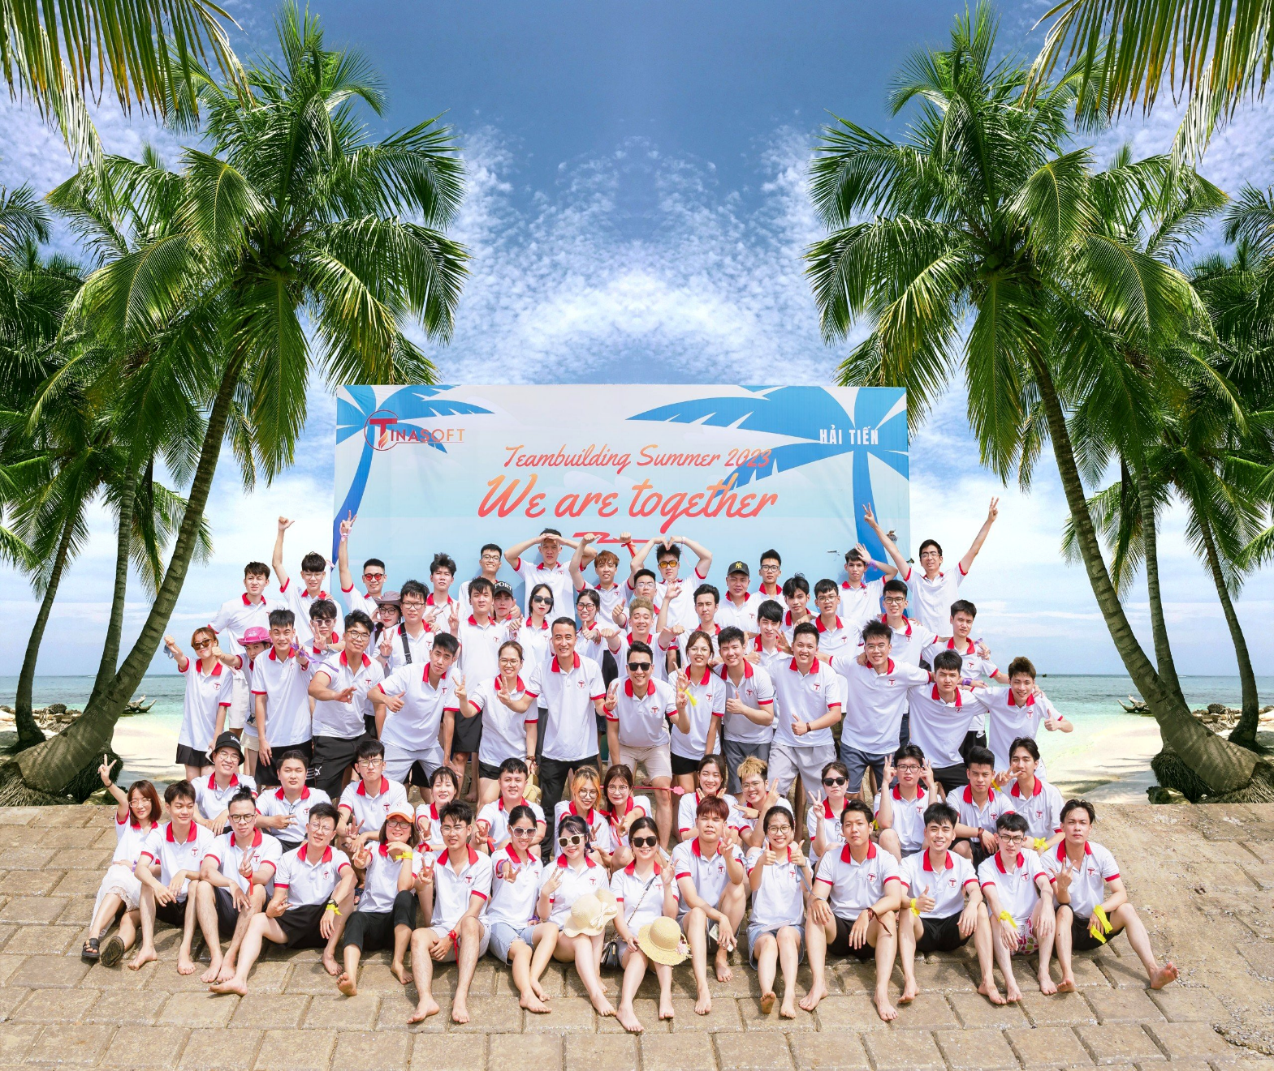
TINASOFT VIETNAM
TINASOFT VIETNAM JOINT STOCK COMPANY
Copyright © 2023 of http://tinasoft.vn/. All rights reserved

Slide 2
Table of content
01
About us
02
Key member
03
Vision, mission, core value
04
Why choose us
05
Our customers
06
Service offering

Slide 3
About us
To be the one-stop destination for all software needs, Tinasoft Vietnam is organized as a group of different system companies covering related domains of expertise, namely Digital Transformation Consulting, Software Development, I.T. Staffing & Sourcing.
https://tinasoft.vn/
LINUX - WINDOWS SERVER
Docker Composer GIT, IoT System, AWS VPS, MongoDB Mysql Postgresql
02
WEBSITE
NODE JS, Nest JS, .NET, PHP Magento, Wordpress, Python, Django, REACT JS, VueJS, Bootstrap, JavaScript, jQuery, HTML, CSS
APP ANDROID - IOS
React native, Java, Swift, Kotlin, Flutter
TOOLS
Trello, Slack, Redmine, Agile Scrum, Gitlab, Github, Skype, Viber, Telegram, Whatsapp

Slide 4
KEY MEMBERS
https://tinasoft.vn/
03
WILLIAM- NGUYEN QUOC UY
NGUYEN THANG HAI AN
LE XUAN HUYNH
COO
TM
Chairman of The Board
TIFFANY- HOANG THU THUY
NGUYEN NGOC HUNG
CEO
CTO

Slide 5
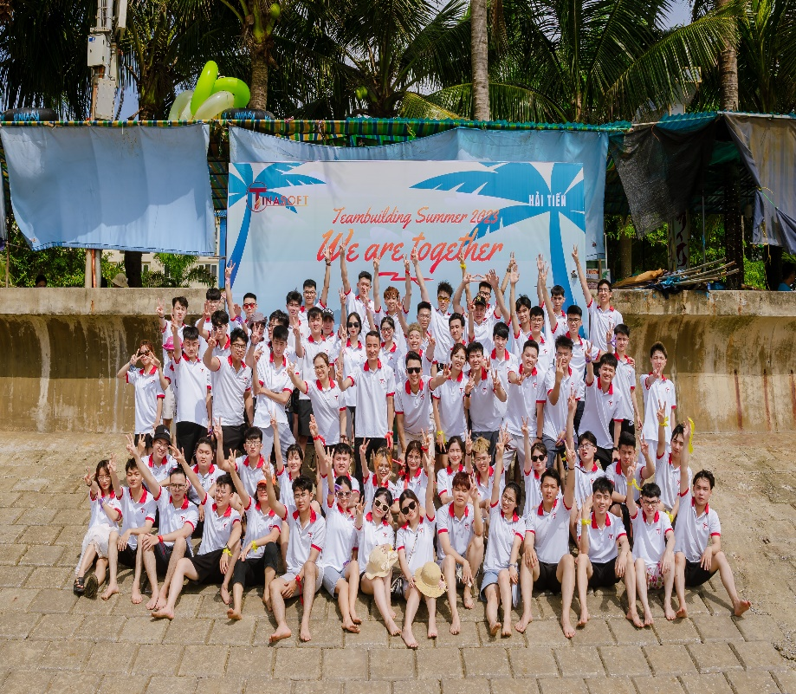
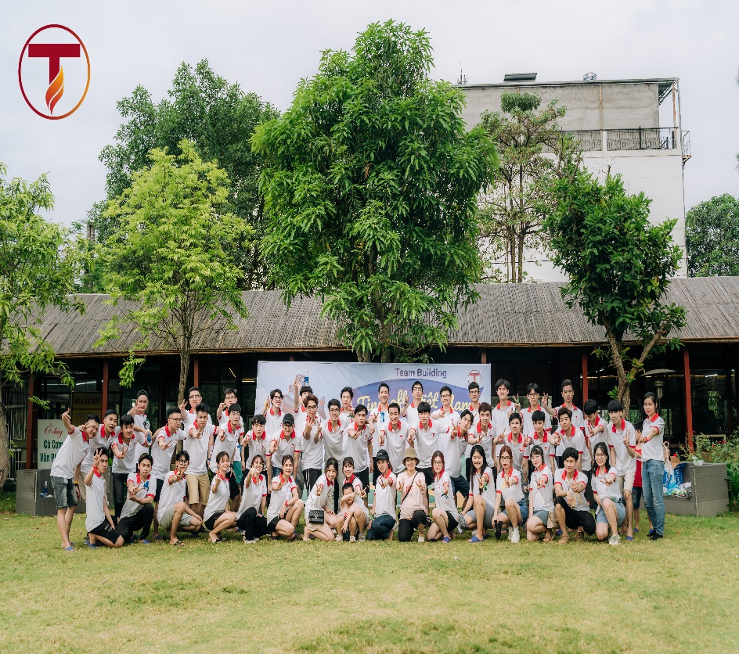
VISION
“Tinasoft Vietnam is going to lead in software solutions, and be known as a professional IT Outsourcing company”
https://tinasoft.vn/
MISSION
“Our mission is to provide comprehensive software solutions, cost-effective, up-to-date technology in the shortest development time.”
04
CORE VALUE
Innovation- Professional- Commitment

Slide 6
WHY CHOOSE US?
https://tinasoft.vn/
Team Stability​
Quality management
The resource turnover rate is less then 10%​.
Resource pool (10% of total team count) is reserved for unforeseen cases​.
We apply ISO 9001:2015 and CMM/CMMi quality management process to ensure output quality.
05
Team Scalability​
Competitive Pricing​
Resources are scalable within 2-8 weeks upon the client request.
Low cost engineers.
Flexible contracts​.

Slide 7
OUR CUSTOMER
https://tinasoft.vn/
300+
PROJECTS
100+
06
America
Korea
PARTNERS
Japan
Việt Nam
Singapore
7+
TARGET MARKETS
Australia
96%
SASTISFACTION

Slide 8
SERVICES OFFERING
Digital Transformation Consulting, Software Development, I.T. Staffing & Sourcing
https://tinasoft.vn/
Website-Mobile app Outsourcing
IoT System
Cosulting IT Solutions
07
IT resource and staff outsourcing
Digital Transformation

Slide 9
OUR CUSTOMERS
https://tinasoft.vn/
09

Slide 10
PROCESS
https://tinasoft.vn/
1.
2.
3.
10
Discussion
Requirement Analysis
Contract signing
4.
5.
6.
7.
Research & Analysis
Design, Code, Deploy & testing
Operate
Maintenance & Support

Slide 11
Website
https://tinasoft.vn/
In Tinasoft, we built a lot of applications and website that our clients can run their solutions in their own market.
Web development services help create all types of web-based software and ensure great experience for web users
11
Full-Scale Web Development:
Business analysis - Front-end development - Back-end development - Integration - Help desk - Continuous support and evolution

Slide 12
MOBILE APPLICATION
We provide Mobile-app Full-Cycle from business ideas to deployment: requirement analysis, design, coding, testing, deployment, maintenance and supporting.
Mobile App Development
iOS and Android Mobile App
React Native App Development
App Maintenance and Support
https://tinasoft.vn/
12
APP IOS
APP ANDROID
Java/Kotlin, MVP, MVVM,
REACT NATIVE
React-Native,
React-Navigation, Redux,
Redux-Saga, TypeScript
Objective-C/Swift, MVP,
MVVM, Clean Swift.

Slide 13
https://tinasoft.vn/
IT STAFF OUTSOURCING (ODC)
We have a talent pool of 100+ skilled IT professionals to fill any gap in technological or vertical expertise in a matter of a few days
13
● Flexible hiring model
● Skilled developers, designers, QA engineers, business analysts, DevOps specialists, and others under your control
● We provide experienced Project Manager to free up your resources for core business activities

Slide 14
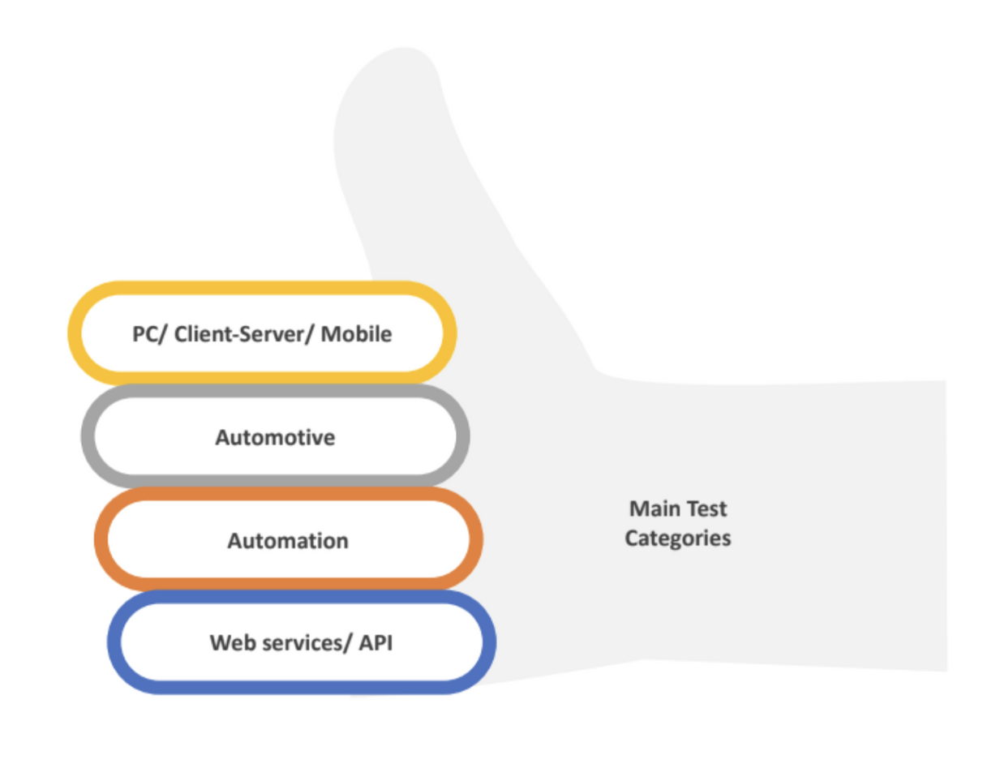
Testing Services
We provides
✔ Automotive, Automation and Manual testing services
✔ Dedicated testing team – with size and for time you actually need
✔ Consulting in the field of testing
methodology, test planning and execution
https://tinasoft.vn/
14

Slide 15
Digital Transformation
https://tinasoft.vn/
Tinasoft integrates digital technology into its business processes to increase operational efficiency, enhance experience and satisfy customers.
ERP, CRM, ODOO: enterprise management suite that help enterprise's instant value across all lines of business
Analytics - Integration - IoT - Security
Digital Transformation Solutions: Tinasoft provides advanced transformation solutions to transform enterprises, while enhancing business values.
15

Slide 16
THANK YOU!
Address
Ellipse Tower, 110 Tran Phu, Ha Dong, Ha Noi, Viet Nam.
Website
Tinasoft.vn
Phone Number
Email
(+84).983.811.938/ (+84).971.479.145
contact@tinasoft.vn

